Slide 1
DEEP LEARNING PAPER IMPLEMENTATION • DL-062
Distilling the Knowledge in a Neural Network
Temperature-scaled knowledge transfer from a ResNet-18 teacher to an ultra-compact CNN student.
Rudransh Mishra (24CS3043)
Original Authors: G. Hinton, O. Vinyals, J. Dean (2015)
B.Tech Computer Science & Engineering, RGIPT
arXiv:1503.02531 • NeurIPS Workshop

Slide 2

01 / CONCEPT & FORMULATION
Soft Targets, Dark Knowledge & Loss
Why Temperature Distillation?
Deployment Gap: Compress 11.17M ResNet-18 into 38.3K CNN (291.9× smaller).
Eq. (1): Softmax with Temperature T
Dark Knowledge: High T exposes similarity ratios on wrong classes.
High-T Limit: Matches squared logit error ½(zᵢ − vᵢ)² scaled by 1/NT².
Section 2: Combined Distillation Loss
T² Multiplier: Prevents soft-target gradient vanishing at high T.

Slide 3
02 / IMPLEMENTATION & BASELINE
PyTorch Module & MNIST Reproduction
Model | Params | Test Acc | Errors
Teacher (Paper) | 2.39M | 99.33% | 67
Distilled (Paper) | 1.28M | 99.26% | 74
ResNet-18 (Ours) | 11.17M | 99.23% | 77
Hard-Only (Ours) | 38.3K | 98.12% | 188
Distilled (T=1, α=0.9) | 38.3K | 98.04% | 196
class DistillationLoss(nn.Module): def __init__(self, T=5.0, alpha=0.1): super().__init__() self.T, self.alpha = T, alpha self.hard_fn = nn.CrossEntropyLoss() self.soft_fn = nn.KLDivLoss(reduction="batchmean") def forward(self, s_logits, t_logits, labels): hard = self.hard_fn(s_logits, labels) s_soft = F.log_softmax(s_logits / self.T, dim=1) t_soft = F.softmax(t_logits / self.T, dim=1) soft = self.soft_fn(s_soft, t_soft) * (self.T**2) return self.alpha*hard + (1-self.alpha)*soft
class DistillationLoss(nn.Module): def __init__(self, T=5.0, alpha=0.1): super().__init__() self.T, self.alpha = T, alpha self.hard_fn = nn.CrossEntropyLoss() self.soft_fn = nn.KLDivLoss(reduction="batchmean") def forward(self, s_logits, t_logits, labels): hard = self.hard_fn(s_logits, labels) s_soft = F.log_softmax(s_logits / self.T, dim=1) t_soft = F.softmax(t_logits / self.T, dim=1) soft = self.soft_fn(s_soft, t_soft) * (self.T**2) return self.alpha*hard + (1-self.alpha)*soft

Slide 4

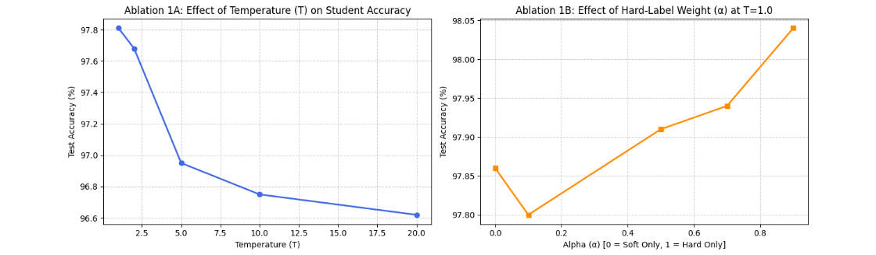
03 / ABLATION STUDY 1
Temperature (T) & Alpha (α) Sweeps
Low T Wins (T=1.0, 97.81%): Tiny 38K student benefits from ignoring noisy negative logits (matches Section 3 of paper).
Higher α Wins (α=0.9, 98.04%): Strong hard-label supervision anchors capacity-constrained student over 4 epochs.

Slide 5

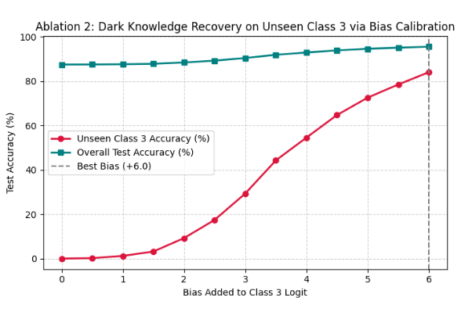
04 / ABLATION STUDY 2 & CONCLUSION
Dark Knowledge on Unseen Digit 3 & Takeaways
UNSEEN DIGIT 3 RECOVERY (+6.0 BIAS)
0.00% → 84.06%
95.55% overall accuracy without seeing a single 3!
Key Takeaways & Limitations
Soft targets transfer relational similarity across classes, while 291.9× compression favors lower temperatures.

